Slide 1
Part –II
DIGITAL ELECTRONICS
Chapter -6 : FLIP FLOPS AND ITS APPLICATIONS
Books :
Malvino and Leach, Digital Principles & applications, 7th edition, TMH, 2010
Morris mano, “Digital design”, Prentice Hall of India ,Third Edition.

Slide 2
Module – 1: Flip Flops and Its Applications
Objectives
At the end of this module, students will be able to:
Differentiate latches and Flip flop.
Draw the circuit of SR, D, JK and D flip-flop using NAND gates and explain its working principle with its truth table.
Design ripple up/down counter using flip flop
Explain the working principle of SISO, SIPO shift registers.

Slide 3

CLASSIFICATION OF DIGITAL CIRCUITS
COMBINATIONAL CIRCUITS :
Examples:
Half Adder, Full Adder etc.
Digital Ckt
Input
Output
Department of Electronics and Communication Engineering, MIT, Manipal
Notes:
Combinational Logic
Circuits that change state depending upon the actual signals being applied to their inputs at that time

Slide 4
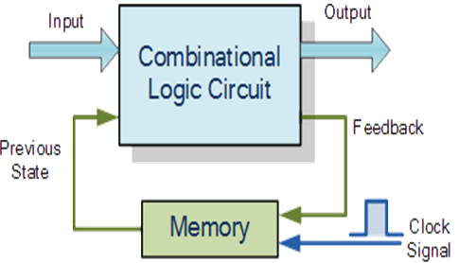
CLASSIFICATION OF DIGITAL CIRCUITS
SEQUENTIAL CIRCUITS:
Simple sequential logic circuits can be constructed from standard Bi-stable circuits such as Flip-flops.
Notes:
SEQUENTIAL CIRCUITS:
The word “Sequential” means that things happen in a “sequence”, one after another and in Sequential Logic circuits, the actual clock signal determines when things will happen next.
In sequential circuits a feedback is always present. Due to this feedback, these circuits have memory. A memory element is a device which can store information in terms of 1 or 0 and its state can be modified by clock signal and data inputs.
Simple sequential logic circuits can be constructed from standard Bi-stable circuits such as Flip-flops.
Practical Examples
Traffic Lights
Digital watches
Timers
Memory sticks
CD

Slide 5
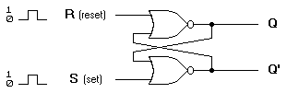
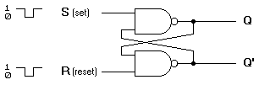
Flip-Flop
An electronic device which is used to store one bit of data
Can be constructed from NAND gates or NOR gates
NOR Logic
NAND Logic
Notes:
Flip Flop
One bit memory element which can store 1 or 0
Can be constructed from NAND gates or NOR gates
Has two stable outputs Q and Q’ so it is known as
Bi-stable circuit.

Slide 6
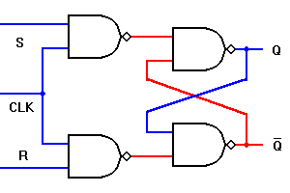
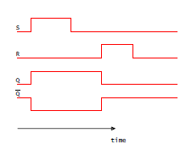
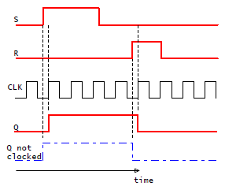
Latch and Flip-Flop
S’R’ Latch
Clocked SR Latch
Or
SR flip-flop
a)
b)
a) Timing diagram of S’R’ Latch b) Timing diagram of clocked SR flip-flop
Notes:
Latches and flip-flops are the basic single-bit memory
elements used to build sequential circuit with one or two
inputs/outputs, designed using individual logic gates and
feedback loops.
• Latches:
– The output of a latch depends on its current inputs
and on its previous inputs and its change of state
can happen at any time when its inputs change.
• Flip-Flop:
– The output of a flip-flop also depends on current
and previous input but the change in output
(change of state or state transition) occurs at
specific times determined by a clock input.

Slide 7

Clock signal
Clock is usually a square wave.
Edges and levels of clock
Positive pulses
Positive edges
Negative edges
Notes:
A “clock” is a special circuit that sends electrical pulses
through a circuit
• Clocks produce electrical waveforms of the form square waves
􀂾 each pulse has a precise width
􀂾 there is a precise interval between pulses – known
as clock cycle time

Slide 8
Memory Elements
Two types of triggering/activation:
pulse-triggered
edge-triggered
Pulse-triggered
latches
ON = 1, OFF = 0
Edge-triggered
flip-flops
positive edge-triggered (ON = from 0 to 1; OFF = other time)
negative edge-triggered (ON = from 1 to 0; OFF = other time)

Slide 9
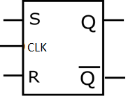
SR Flip Flop
Logic Diagram of SR flip flop.
Logic Symbol of SR flip flop
Table 1: Truth table of SR Flip flop.
CLK | S | R | Q(n+1) | Mode
1 | 0 | 0 | Qn | Previous Output
1 | 0 | 1 | 0 | Reset
1 | 1 | 0 | 1 | Set
1 | 1 | 1 | Invalid | Invalid
0 | X | X | Qn | Previous Output
Notes:
During Clk High:
When S input is made ‘1’ and R input is made ‘0’, the Q output takes the state ‘1’. We call this as SET condition.
When S input is made ‘0’ and R input is made ‘1’, the Q output takes the state ‘0’. We call this as RESET condition
When S = R = ‘0’ . the SR flip flop exhibits the memory. i.e. Q_{n+1} = Q_{n}
S = R = 1 is the Invalid Condition.
During Clk Low:
Irrespective of S and R inputs, the SR flip flop exhibits the memory. i.e. Q_{n+1} = Q_{n}

Slide 10
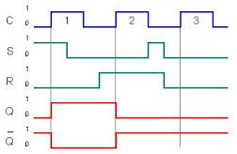
Timing Diagram of SR Flip Flop
SR flip flop timing diagram

Slide 11
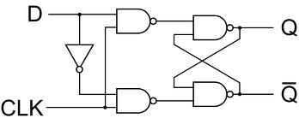
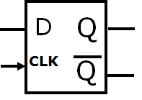
D Flip Flop
(a) Logic Diagram of D flip flop. (b) Logic Symbol of D flip flop.
Table2: Truth table of D flip flop.
CLK | D | Q(n+1) | Mode
1 | 0 | 0 | Reset
1 | 1 | 1 | Set
0 | X | Qn | Previous Output

Slide 12
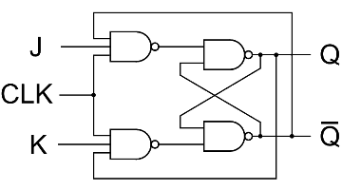

JK Flip Flop
(a) Logic Diagram of JK flip flop.
(b) Logic Symbol of JK flip flop.
Table 3: Truth table of JK Flip flop.
CLK | J | K | Q(n+1) | Mode
1 | 0 | 0 | Qn | Previous Output
1 | 0 | 1 | 0 | Reset
1 | 1 | 0 | 1 | Set
1 | 1 | 1 | Qn’ | Toggle
0 | X | X | Qn | Previous Output
Notes:
During Clk High:
J = K = 0 causes memory condition.
J = 0 & K = 1 causes reset condition.
J = 1 & K = 0 causes set condition.
J = K = 1 causes output to toggle. i.e. Q_{n+1} = Q_{n}’
During Clk low:
Irrespective of J & K inputs, the J-K flip flop exhibits the memory condition.

Slide 13
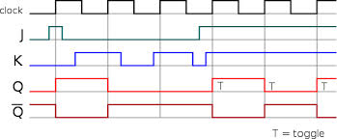
Timing diagram of JK fliop-flop

Slide 14
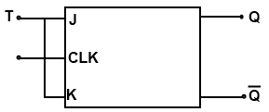
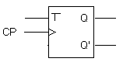
T Flip-flop
(a) Logic Diagram of T flip flop.
(b) Logic Symbol of T flip flop.
Table 4: Truth table of T flip flop.
CLK | T | Q(n+1 | Mode
1 | 0 | Qn | No change
1 | 1 | Qn’ | Toggle
0 | X | Qn | No change

Slide 15
Symbolic Representation of Edge-Triggered Flip-flops
S-R, D and J-K edge-triggered flip-flops. Note the “>” symbol at the clock input.
S
C
R
Q
Q'
D
C
Q
Q'
J
C
K
Q
Q'
Positive edge-triggered flip-flops
S
C
R
Q
Q'
D
C
Q
Q'
J
C
K
Q
Q'
Negative edge-triggered flip-flops

Slide 16
Self Test
How you convert SR flip flop to D flip and T flip flop?
Differentiate
a) SR and JK flip flop
b) T and D flip-flop.

Slide 17
Binary Counters
Basic Structure
State of the counter
Modulus of the counter
In general an n-bit counter will have ‘n’ flip flops and 2^{n} states and divides the input frequency by 2^{n}. Hence it is a divide by 2^{n} counter
Notes:
Is a set of flip flops whose states change in response to pulses applied at the input to the counter.
Used to count pulses
Basic Structure:
In binary counter, the flip flops are interconnected such that their combined state at any time is the binary equivalent of the total number of pulses that have occurred up to that time.
state of the counter:
Each of the counts of the counter is called state of the counter
Modulus of the counter
The number of states through which the counter passes before returning to the starting state is called modulus of the counter
In general an n-bit counter will have ‘n’ flip flops and 2^{n} states and divides the input frequency by 2^{n}. Hence it is a divide by 2^{n} counter

Slide 18
Classification of counters
Synchronous and Asynchronous counters
Up counter or Down Counter
–ve edge triggered or +ve edge triggered

Slide 19
Ripple Counters
Asynchronous counters
Uses T topology
Also called as serial or series counters.
Notes:
T (Toggle ) topology:
It make use of Toggle property of the flip flop. Usually JK flip flops or T flip flops are used with J and K inputs or T input of the flip flops connected to 1.

Slide 20
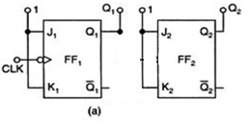
Example
Design Two bit ripple up counter using negative edge triggered flip flops using JK flip flop
Steps:
Select 2 JK flip flops (number of flip flops depends upon number of bits to count).
Connect JK inputs to high
Apply the –ve edge clock pulse to first JK flip flop as shown

Slide 21
Two bit ripple up counter using -ve edge triggered flip flops
Write the truth table of 2 bit up counter
Q₂ is changing when Q₁ is changing from 1 to 0 which represents –ve edge.
Hence connect Q₁ as the clock for the next flip flop
Clk pulse | Q₂ | Q₁(LSB)
1 | 0 | 0
2 | 0 | 1
3 | 1 | 0
4 | 1 | 1
Notes:
Write the truth table of 2 bit up counter as shown where Q1 and Q2 are the outputs of 2 JK flip flops
Observe when higher bit (Q2) is changing. Q2 is changing when Q1 is changing from 1 to 0 which represents –ve edge.
Hence connect Q1 as the clock for the next flip flop

Slide 22
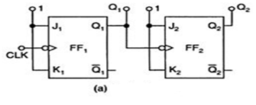



Two bit ripple up counter using -ve edge triggered flip flops
a)Asynchronous 2 bit up counter using -ve edge triggered flip flops
(b) Timing diagram
What happens if Q’₁ is connected as clock for the next flip flop?
How to design +ve edge triggered up/down counters ?

Slide 23
Application: Frequency division
High
High
High
J
C
K
J
C
K
QA
J
C
K
QB
Q
CLK
CLK
CLK
CLK
Q
QA
QB
Divide clock frequency by 2.
Divide clock frequency by 4.

Slide 24
Applications of counter
Used as frequency divider
In digital watches
To create time delays
To produce non-sequential binary counts
To generate pulse trains
To act as frequency counters

Slide 25
Self test
What is the modulus of 2 bit counter?
Why ripple counters are known as divide by n counter (In case of 2 bit counter, it is divide by 2 counter) ?
( * Hint: Observe the waveforms and analyze the frequency of the n^{th} flip flop output with respect to clock signal)
Realize 2 bit +ve edge triggered up counter using T flip flop.

Slide 26
Exercises
Design mod 4 down counter using +ve edge triggered T flip flop.
Design 4 bit up counter using –ve edge triggered JK flip flop with the neat timing diagram
Design decade counter using +ve edge triggered JK flip flop with the neat timing diagram

Slide 27
Shift Register
Registers are digital circuits which are used to store ‘n’ bits information in the same time.
built with D topology
All these flip flops are driven by a common clock and they are set or reset simultaneously.

Slide 28
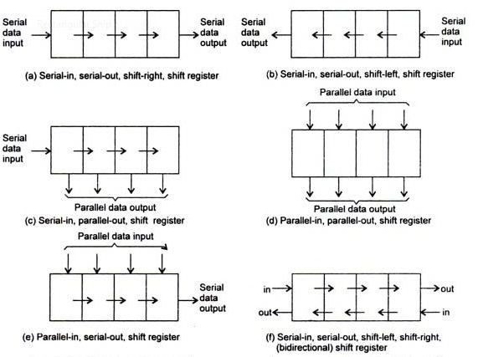
Shift Register
Data transmission in shift register

Slide 29
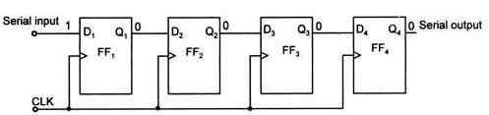
Serial In Serial Out Shift Register (SISO)
Data 1010 shifting in 4 bit SISO shift register if data entered from LSB
Clk Pulse | Q1 | Q2 | Q3 | Q4
Before the CLK | # | # | # | #
Clk 1 | 0 | # | # | #
Clk 2 | 1 | 0 | # | #
Clk 3 | 0 | 1 | 0 | #
Clk 4 | 1 | 0 | 1 | 0
Clk 5 | # | 1 | 0 | 1
Clk 6 | # | # | 1 | 0
Clk 7 | # | # | # | 1
Clk 8 | # | # | # | #
Data is loaded
MSB is available
# is any random data

Slide 30
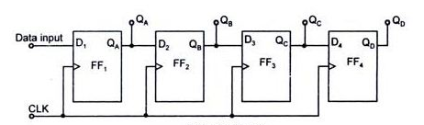
Serial In Parallel Out Shift Register (SIPO):
Parallel Outputs
Data 1010 shifting in 4 bit SIPO shift register if data entered from LSB
Clk Pulse | Q1 | Q2 | Q3 | Q4
Before the CLK | # | # | # | #
Clk 1 | 0 | # | # | #
Clk 2 | 1 | 0 | # | #
Clk 3 | 0 | 1 | 0 | #
Clk 4 | 1 | 0 | 1 | 0
Data is loaded and can be taken out

Slide 31
Applications of shift Registers
To store digital data during arithmetic and logical operations
Used in building Shift register counters such as simple ring counter and the Johnson counter

Slide 32
Self Test
Compare SISO and SIPO
List the applications of SISO and SIPO

Slide 33
Exercises
Consider data 101110 is given to SISO,SIPO. Data is entered from LSB. After how many clock pulse, MSB is retrieved?
Design 5 bit SISO and SIPO shift register and with the help of table explain the working for data bits 1011001 entered from LSB.

Slide 34
Summary
Flip flops are sequential circuits and can be constructed with NOR or NAND gates
Flip flop is an edge triggered , one bit memory device
Commonly used flip flops are – SR, D, JK and T flip flop
Flip flops are used in many applications like counters, shift registers

Slide 35
Summary
Counters can be Asynchronous or Synchronous , Up or down counters.
In general an n-bit counter will have ‘n’ flip flops and 2^{n} states and divides the input frequency by 2^{n}. Hence it is a divide by 2^{n} counter
Ripple counters are Asynchronous counters and constructed using T topology

Slide 36
Summary
Shift registers are built with D topology
All these flip flops are driven by a common clock and they are set or reset simultaneously.
Shift registers are classified depending on the data loading methods, shifting methods and data receiving methods

